Slide 1
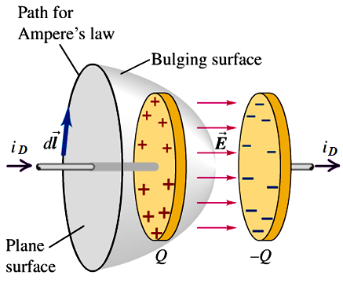








Review of Ch32
We can express the “current” by the rate of flux Φ_{E} in terms of charge q
∴
Displacement current

Slide 2




Review of Ch32
* Assume there is no dielectric or magnetic materials present
Net electric flux
Net enclosed electric charge
Net magnetic flux
Net enclosed magnetic charge
Induced E-field
Changing magnetic flux
Induced B-field
Changing electric flux and current

Slide 3
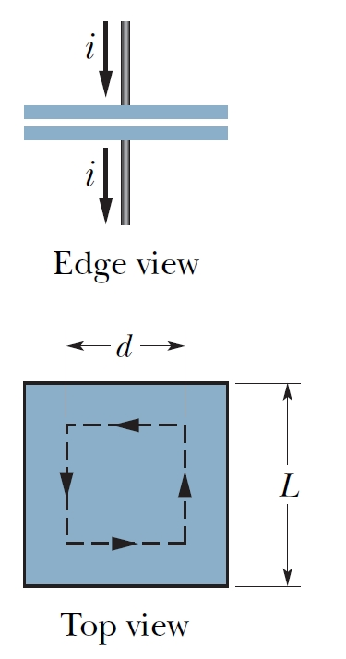
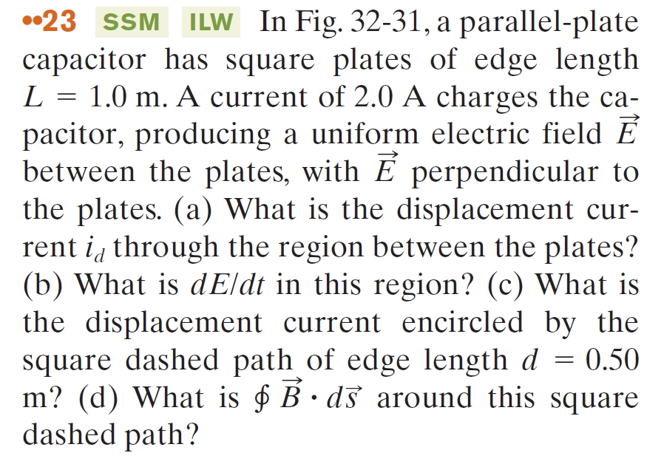
Review of Ch32
A problem for chapter 32:

Slide 4
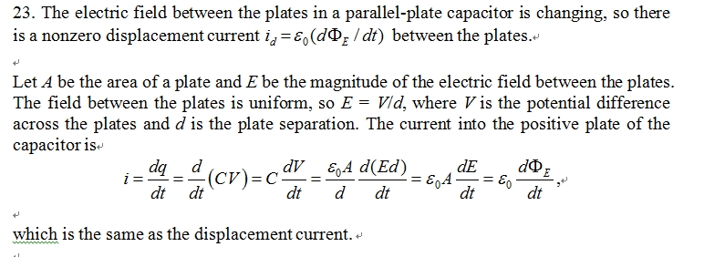
Review of Ch32
Solution:

Slide 5
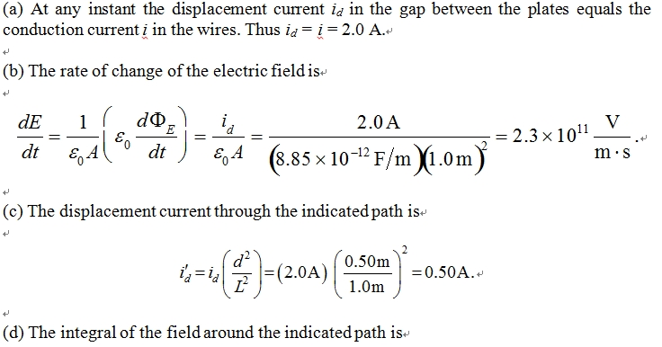
Review of Ch32

